Slide 1
OPEN CALLS IN HORIZON 2020
Dr. Michalis Tzatzanis
FFG – Austrian Research Promotion Agency
17 Feb. 2016

Slide 2
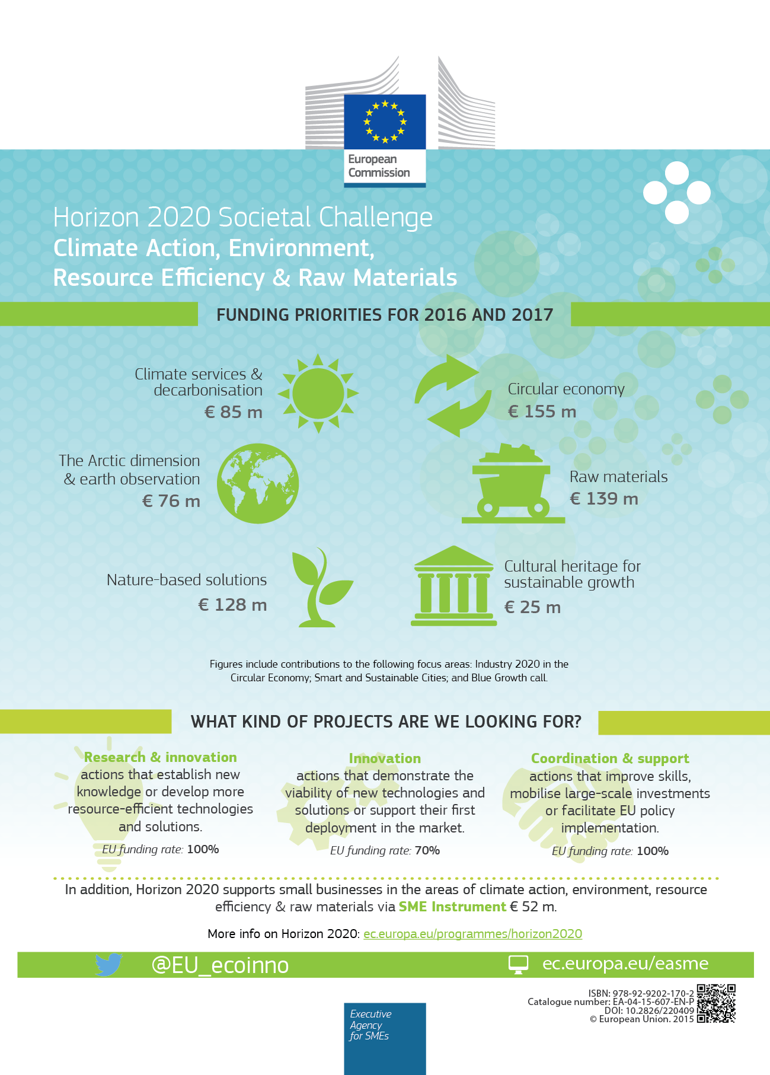
Open CALLS 2016-2017

Slide 3
Open CALLS 2016-2017

Slide 4
Open TOPICS IN 2016
Climate services & decarbonisation
Call topic | Deadline | Deadline
 | 1st stage | 2nd stage
SC5-01-2016-2017 (IA, 5 M€): | 8 March 2016 17:00:00 CET | 6 September 2016 17:00:00 CET
Exploiting the added value of climate services a) Demonstration of climate services
SC5-03-2016 (RIA, 1.5 M€): | 8 March 2016 17:00:00 CET | ---
Climate services market research Proposals should address only one of the following: a) Defining the European and international climate service market characteristics and foresight into market growth b) Climate services market barriers and enabling conditions
SC5-06-2016-2017: | 8 March 2016 17:00:00 CET | ---
Pathways towards the decarbonisation and resilience of the European economy in the timeframe 2030-2050 and beyond Proposals should address only one of the following: a) Managing technology transition – RIA, 4-6 M€ b) Assessment of the global mitigation efforts in the perspective of the long-term climate goal – RIA, 2-3 M€

Slide 5
Open TOPICS IN 2016
The Arctic dimension & earth observation
Call topic | Deadline | Deadline
 | 1st stage | 2nd stage
BG-09-2016 (RIA, 15 M€): | 17 February 2016 17:00:00 CET | ---
An integrated Arctic observation system
BG-10-2016 (RIA, 7-8 M€): | 17 February 2016 17:00:00 CET | ---
Impact of Arctic changes on the weather and climate of the Northern Hemisphere
BG-12-2016 (RIA, 8 M€): | 17 February 2016 17:00:00 CET | 13 September 2016 17:00:00 CET
Towards an integrated Mediterranean Sea Observing System
SC5-05-2016 (CSA, 5 M€): | 8 March 2016 17:00:00 CET | ---
A 1.5 million year look into the past for improving climate predictions
SC5-20-2016 (RIA, 9-10 M€): | 8 March 2016 17:00:00 CET | ---
European data hub of the GEOSS information system

Slide 6
Open TOPICS IN 2017
Climate services & decarbonisation
Call topic | Deadline
SC5-01-2016-2017 (RIA, 5 M€): | 7 March 2017 17:00:00 CET
Exploiting the added value of climate services b) From climate service concepts to piloting and proof-of-concept
SC5-02-2017 (RIA, 13 M€): | 7 March 2017 17:00:00 CET
Integrated European regional modelling & climate prediction system
SC5-04-2017 (RIA, 10 M€): | 7 March 2017 17:00:00 CET
Towards a robust and comprehensive greenhouse gas verification system

Slide 7
Open TOPICS IN 2017
The Arctic dimension & earth observation
Call topic | Deadline
BG-11-2017 (RIA, 10 M€): | 14 February 2017 17:00:00 CET
The effect of climate change on Arctic permafrost and its socio-economic impact, with a focus on coastal areas
SC5-18-2017 (RIA, 4-5 M€): | 7 March 2017 17:00:00 CET
Novel in-situ observation systems
SC5-19-2017 (CSA, 1 M€): | 7 March 2017 17:00:00 CET
Coordination of citizens' observatories initiatives

Slide 8
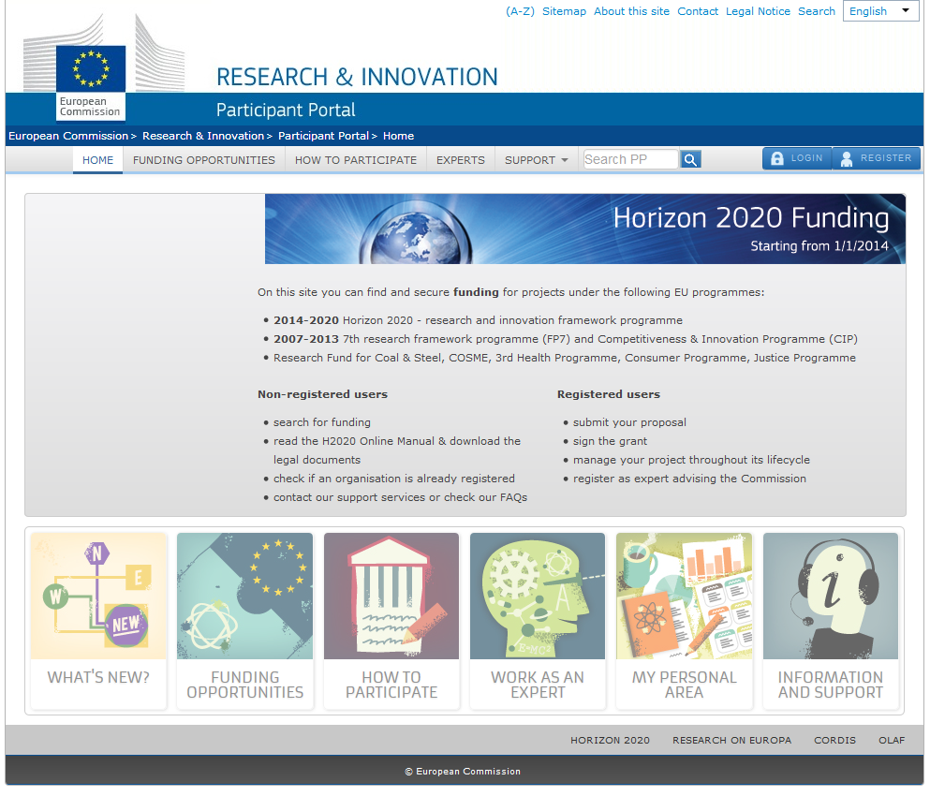
PARTICIPANTs PORTAL
http://ec.europa.eu/research/participants/portal
complete topic texts
all reference documents
proposal templates
online submission system

Slide 9
KLIMA-WORKSHOP AM 15. APRIL 2016
„Horizon 2020 – Herausforderung Klimawandel und österreichisch-französische Forschungspartnerschaften“
Hauptziel dieser Veranstaltung ist, die österreichisch-französische Forschungs-kooperation im Bereich Klimaforschung zu vertiefen. Die Konferenz soll auch die Themen Klimadienstleistungen (inkl. Erbeobachtung) und Dekarbonisierung aus dem Horizon 2020 Arbeitsprogramm 2017 vorstellen.
Wann: Freitag, 15. April 2016 von 9:30 bis 16:30 Uhr
Wo: Französisches Kulturinstitut, Währinger Straße 30, 1090, Wien, Österreich.
Informationen und Anmeldung:
http://tinyurl.com/FR-AT-climate
Etienne.gonon-pelletier@diplomatie.gouv.fr

Slide 10
ADVICE AND CONTACT
Societal Challenge 5:
    Dr. Michalis Tzatzanis
    @ michalis.tzatzanis@ffg.at
     05 7755 4405
FFG website:
    https://www.ffg.at/Europa/
    https://www.ffg.at/klimaschutz-ressourceneffizienz-und-rohstoffe

