Slide 1
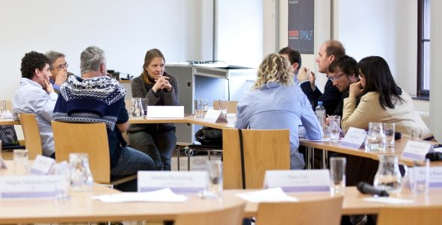
CCCA Servicecentre Round Table Graz, December 9th 2016
www.ccca.ac.at

Slide 2
The climate change centre Austria (CCCA)
Austrian alliance of climate research and climate impact research institutions
Goals:
Strengthening the Austrian climate research community
Facilitate the education of young researchers
Support knowledge transfer (e.g. science to science, science to public)
Advise society and decision makers (e.g. public administration)

Slide 3

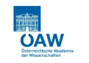






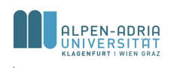












Our network today
23 research institutions as members
The CCCA executive board
3 operative entities:
Secretariat
Service Centre
Data Centre
DZ
SZ
GS
Our executive board:
Wolfgang Schöner | Universität Graz
Angela Michiko Hama | alpS
Herbert Formayer | BOKU Wien
Helmut Haberl | AAU
Andreas Richter | Universität Wien
Elisabeth Riegler | Umweltbundesamt
Claudia Kettner | WIFO
Gerhard Wotawa | ZAMG
Johann Stötter | Universität Innsbruck
VORSTAND

Slide 4
Upcoming opportunities for CCCA members

Slide 5
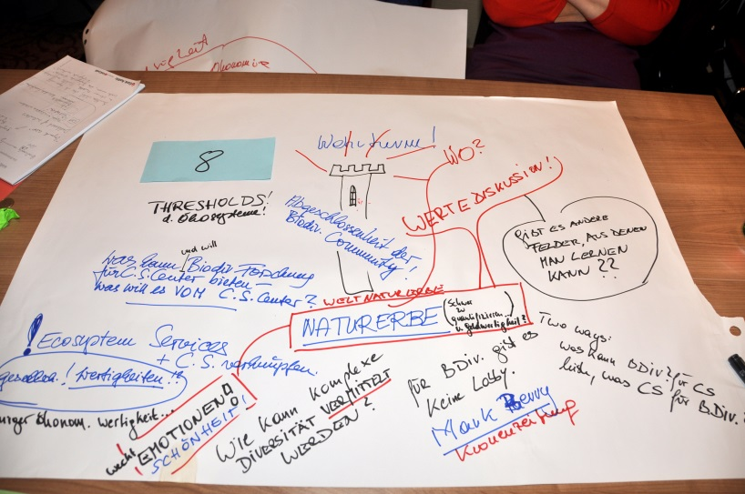
Call for networking projects/activities
Max. € 10.000,- per project
No research projects!
DDL for submission: January 8th 2016
The (virtual) general assembly decides
Project duration: max. one year
Project supports the CCCA goals
Inter- or transdisciplinary orientation
3 or more member institutions involved (international partners are welcome)
http://www.ccca.ac.at/de/ccca-aktivitaeten/vernetzungsprojekte/

Slide 6

Science Plan
Science Plan = Common, national strategic research agenda for Austria
Online Commenting phase (coming soon)
http://www.ccca.ac.at/de/ccca-aktivitaeten/science-plan/

Slide 7
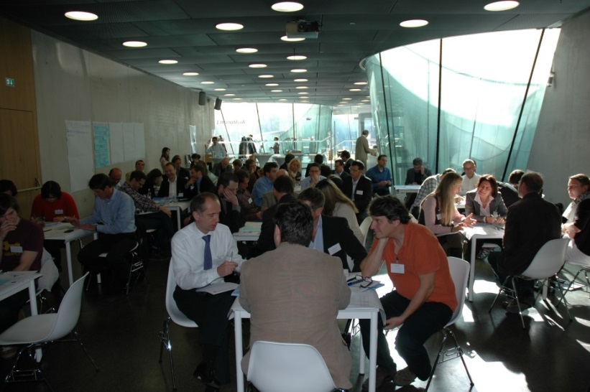
Climate Day: Pre-Day
Working groups for young scientists 10.00-12.00:
Participation and survey techniques in climate impact research Sebastian Seebauer (WEGC; University of Graz): questionnaire design, sampling, methods for data collection Andrea Prutsch (Environment Agency Austria): participation and stakeholder integration
Climate risks and extreme events Reinhard Mechler & Stefan Hochrainer-Stigler, (IIASA/WU Wien): risk modelling and analyses of extreme events and climate risks Dirk Muschalla (TU Graz): modelling urban floods
Climate data and scenarios: handling and data quality Herbert Formayer (BOKU Wien): meteorological measuring techniques Heimo Truhetz (WEGC, University of Graz): regional climate projections Chris Schubert (CCCA Data Centre): Data queries at the CCCA Data Centre
Innovation- and transition research in climate sciences Romana Rauter (ISIS, University of Graz) Willi Haas (IFF, AAU Klagenfurt)
Case studies and methods for upscaling and transfer Birgit Bednar-Friedl (WEGC, University of Graz) Thomas Glade (University of Vienna)

Slide 8
Climate Day: Pre-Day (April 6th 2016)
Working groups for young scientists 14.00-16.00:
Wissenschaftliche Ergebnisse für die Praxis aufbereiten (Carel Mohn, klimafakten.de) (Language: German)
Verfassen von Presseartikeln auf Basis wissenschaftlicher Ergebnisse (Dagmar Eklaude, Uni Graz Pressestelle) (Language: German)
Feedback on research proposals and scientific papers (Herbert Formayer, BOKU & Birgit Bednar-Friedl, Uni Graz) (Language: German/English)
Visual displays: What characterizes a good chart? (Bettina Lackner, Uni Graz) (Language: German/English)
Story telling & oral media: Talking about your research in an interview situation (Walther Moser, Radio Helsinki (Language: German/English)
+ open space
http://www.ccca.ac.at/de/ccca-aktivitaeten/oesterr-klimatag/klimatag-2016/

Slide 9
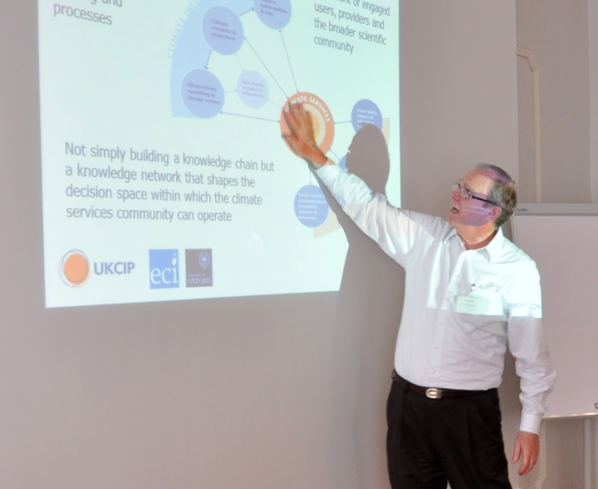
Supporting activities for CCCA young scientists in 2016
CCCA working group leader: Sebastian Seebauer, Wegener Center, Universität Graz
CCCA contact: Angelika Wolf
Examples:
Summer/Winter School
Organized by CCCA members, co-funded by CCCA
Travel allowances
Workshops

Slide 10
Ongoing opportunities for CCCA members

Slide 11
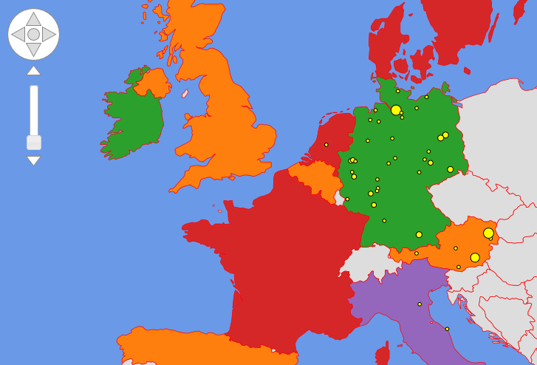
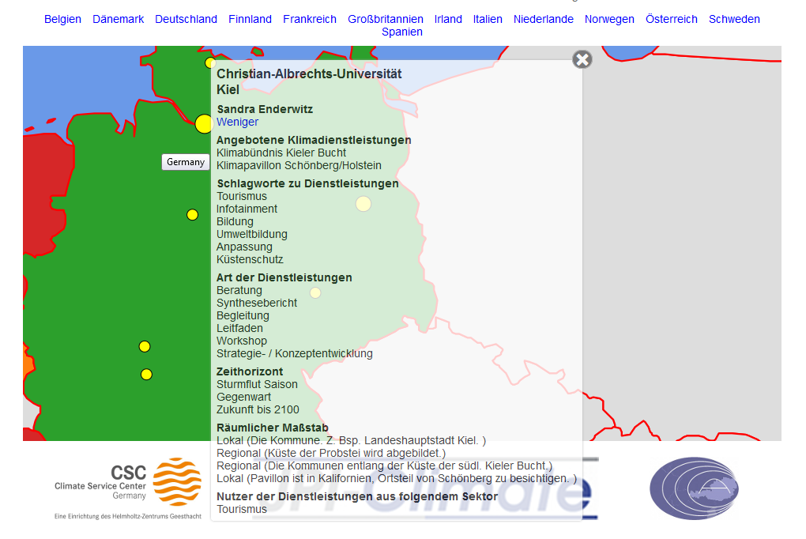


International outreach
Upload your profile as climate research expert and provider of climate services
www.climate-knowledge-hub.org

Slide 12
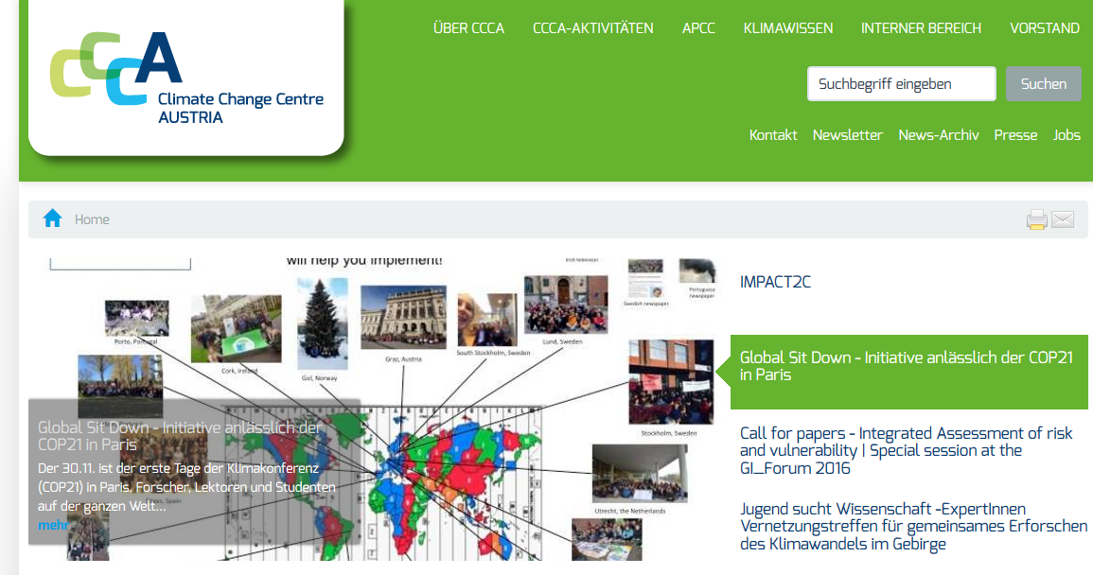
National outreach & networking
Use our Homepage and our CCCA Newsletter to promote your events, publications and research to the CCCA community
Approach us for setting up networking workshops (e.g. Wegener Center: Situation of climate protection law in Austria, November 23rd, 2015)

Slide 13
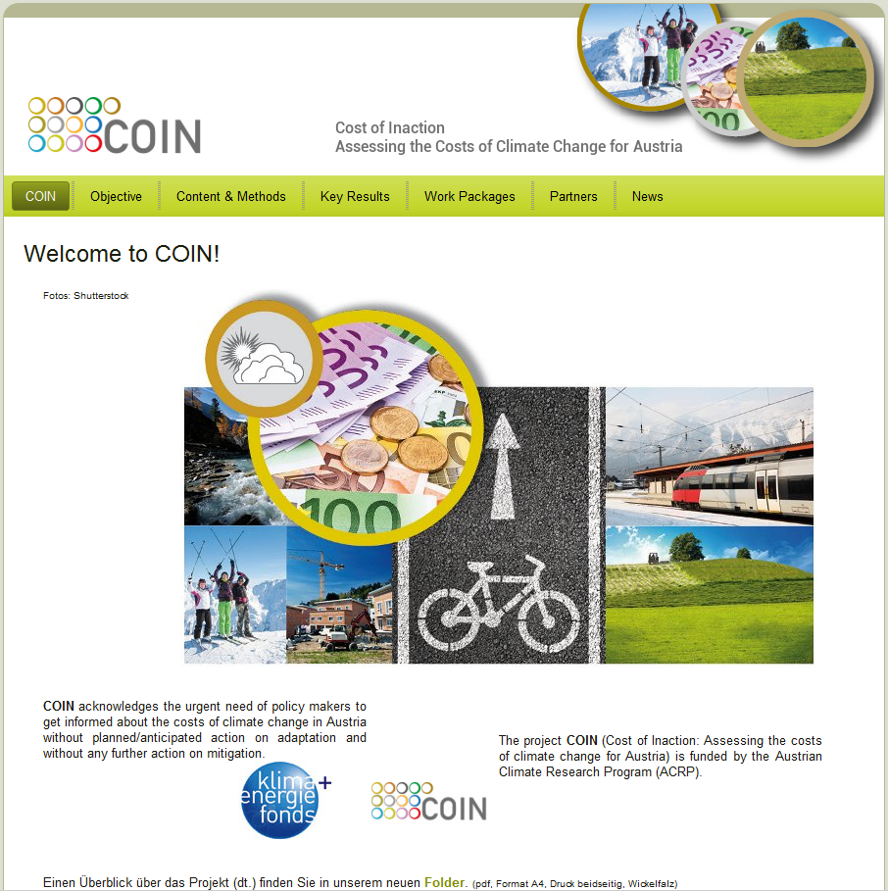
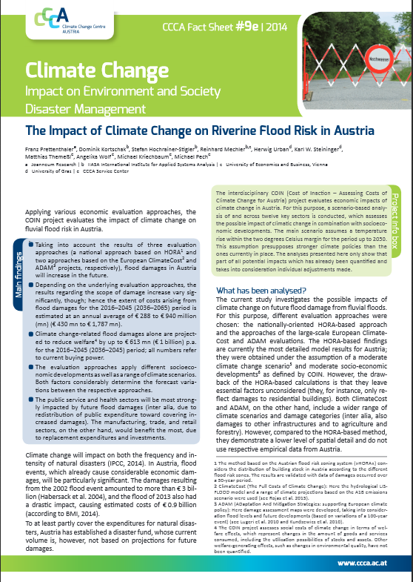
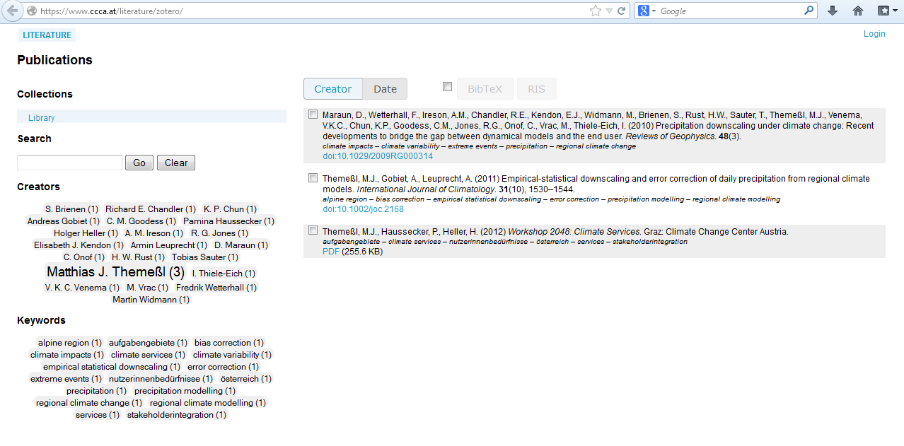
Products & ressources
Examples:
Development of project homepages & logos
Literature database
Development of a glossary (together with APCC)
Fact Sheets

Slide 14
Climate Change Centre Austria Service Centre Krenngasse 37/1 8010 Graz Matthias Themeßl Angelika Wolf Stefan Ropac Heide Spitzer

